Slide 1
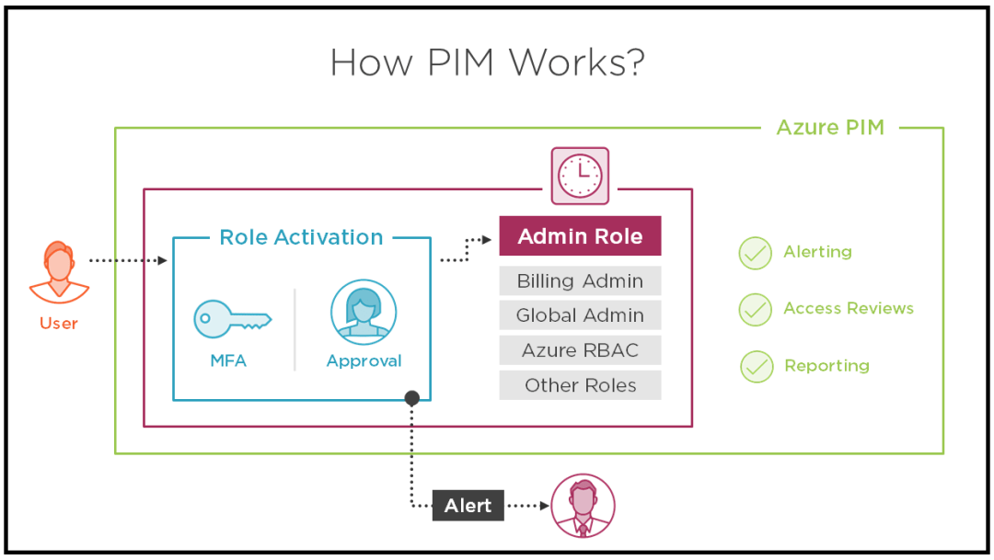
If you want a specified user to be able to implement Azure ad privileged identity management (also called PIM); the user must be with global administrator role in the organizational account (not a Microsoft account).
Steps : 1- to start using PIM in your directory, you must first enable PIM, 2- sign into the Azure portal as global administrator of your directory. 3 - you must be a global administrator with an organizational account (for example user@yourdomain.com, not @Microsoft account)

Slide 2

Your company has an Active Directory forest with a single domain, named weylandindustries.com. They also have an Azure Active Directory (Azure AD) tenant with the same name. You have been tasked with integrating Active Directory and the Azure AD tenant. You intend to deploy Azure AD Connect. Your strategy for the integration must make sure that password policies and user logon limitations affect user accounts that are synced to the Azure AD tenant, and that the number of necessary servers are reduced.
For pass-through authentication (and seamless SSO with password hash synchronization), you need one or more (we recommend three) lightweight agents installed on existing servers. These agents must have access to your on-premises Active Directory Domain Services, including your on-premises AD domain controllers. They need outbound access to the Internet and access to your domain controllers. For this reason, it's not supported to deploy the agents in a perimeter (DMZ) network.
www.docs.microsoft.com/en-us/azure/active-directory/hybrid/how-to-connect-pta

Slide 3
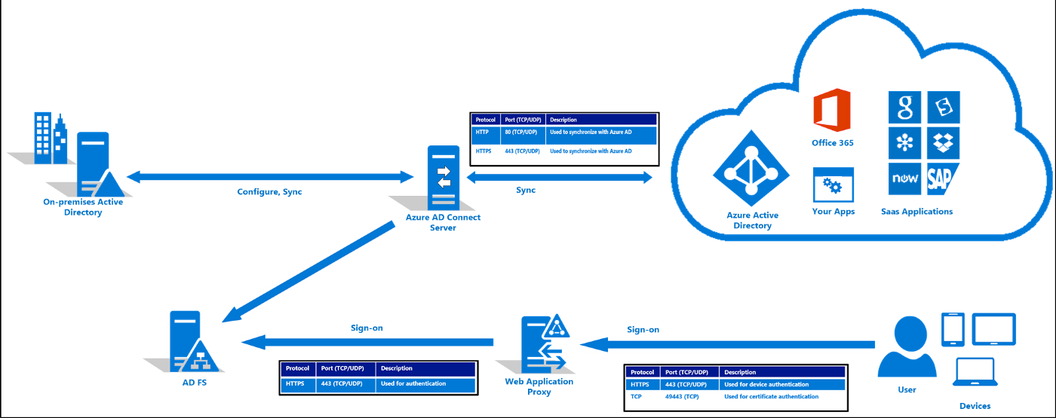
Your company has an Active Directory forest with a single domain, named weylandindustries.com. They also have an Azure Active Directory (Azure AD) tenant with the same name. You have been tasked with integrating Active Directory and the Azure AD tenant. You intend to deploy Azure AD Connect. Your strategy for the integration must make sure that password policies and user logon limitations affect user accounts that are synced to the Azure AD tenant, and that the number of necessary servers are reduced.
- A federated authentication system relies on an external trusted system to authenticate users. Some companies want to reuse their existing federated system investment with their Azure AD hybrid identity solution. The maintenance and management of the federated system falls outside the control of Azure AD. It's up to the organization by using the federated system to make sure it's deployed securely and can handle the authentication load.

Slide 4
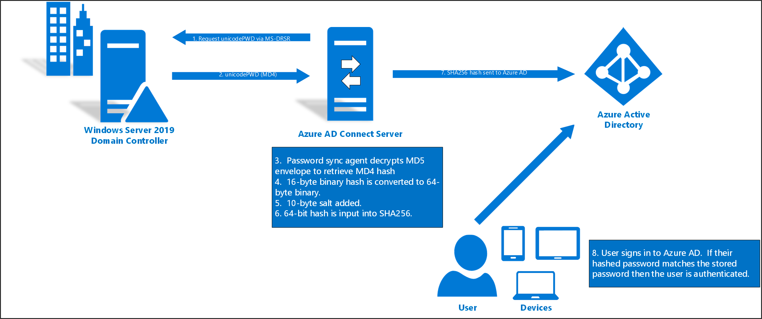
Your company has an Active Directory forest with a single domain, named weylandindustries.com. They also have an Azure Active Directory (Azure AD) tenant with the same name. You have been tasked with integrating Active Directory and the Azure AD tenant. You intend to deploy Azure AD Connect. Your strategy for the integration must make sure that password policies and user logon limitations affect user accounts that are synced to the Azure AD tenant, and that the number of necessary servers are reduced.
- Recommend the use of password hash synchronization and seamless SSO. Password hash synchronization requires the least effort regarding deployment, maintenance, and infrastructure. This level of effort typically applies to organizations that only need their users to sign into Office 365,
SaaS apps, and other Azure AD-based resources. When turned on, password hash synchronization is part of the Azure AD Connect sync process and runs every two minutes.

Slide 5
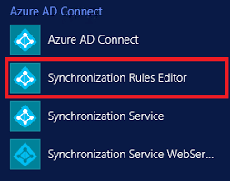
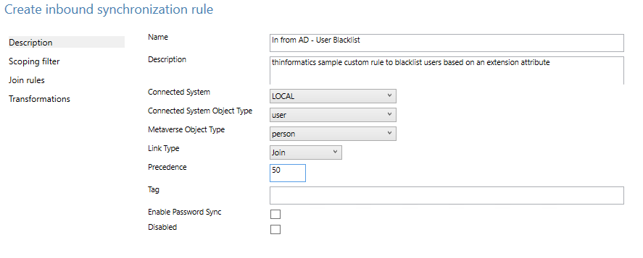
Your company has an Active Directory forest with a single domain, named weylandindustries.com. They also have an Azure Active Directory (Azure AD) tenant with the same name. After syncing all on-premises identities to Azure AD, you are informed that users with a givenName attribute starting with LAB should not be allowed to sync to Azure AD.
- You should make use of the Synchronization Rules Editor to create an attribute -based filtering rule.
Explanation: Use the Synchronization Rules Editor and write attribute-based filtering rule

Slide 6
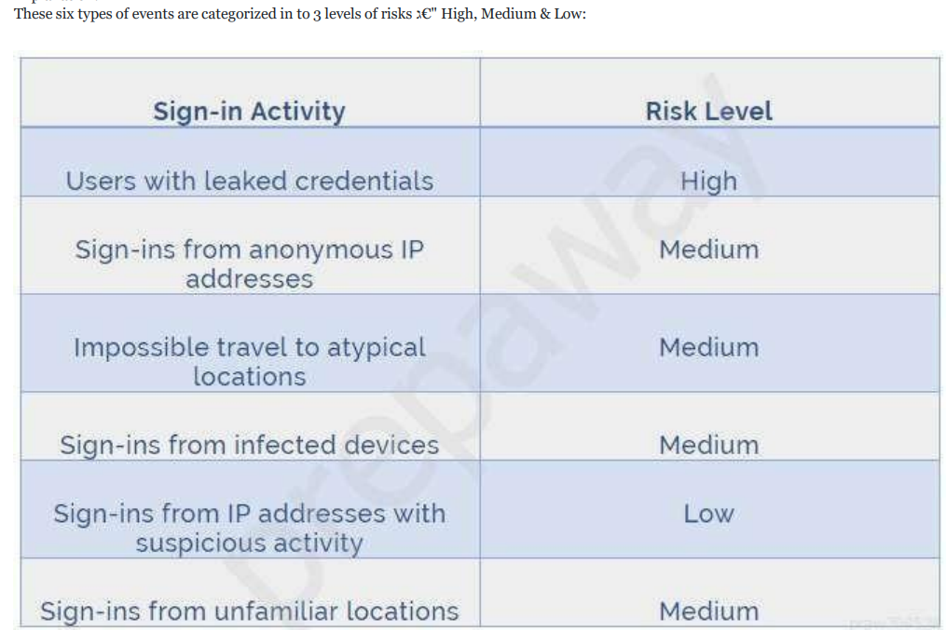

Slide 7
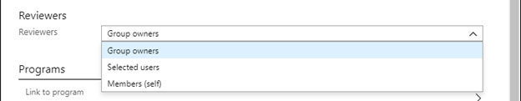
In the Reviewers section, select either one or more people to review all the users in scope. Or you can select to have the members review their own access. If the resource is a group, you can ask the group owners to review.

Slide 8
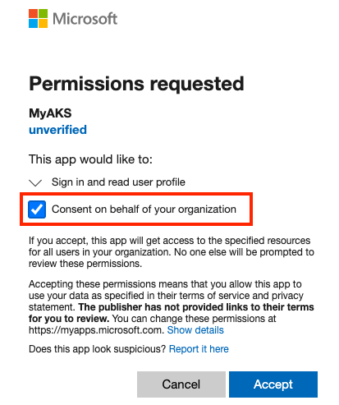
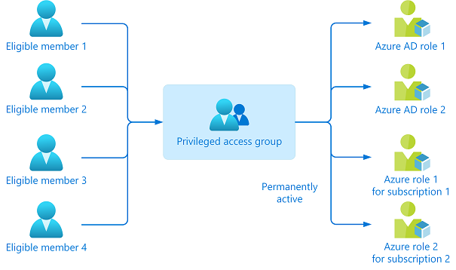
Your company recently created an Azure subscription. You have subsequently, been tasked with making sure that you are able to secure Azure AD roles by making use of Azure Active Directory (Azure AD) Privileged Identity Management (PIM). What action should you take FIRST?
- You should consent to Azure Active Directory (Azure AD) Privileged Identity Management (PIM).

Slide 9
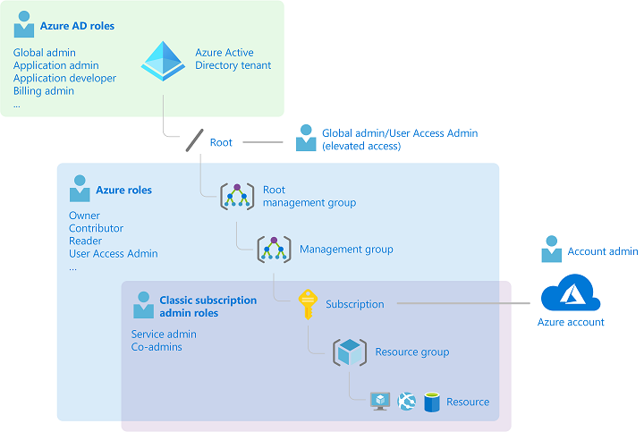
You have been tasked with creating a different subscription for each of your companyגs divisions. However, the subscriptions will be linked to a single Azure Active Directory (Azure AD) tenant. You want to make sure that each subscription has identical role assignments. You make use of Azure AD Privileged Identity Management (PIM).
No adjustment required - Azure AD Privileged Identity Management (PIM) service also allows Privileged Role Administrators to make permanent admin role assignments

Slide 10
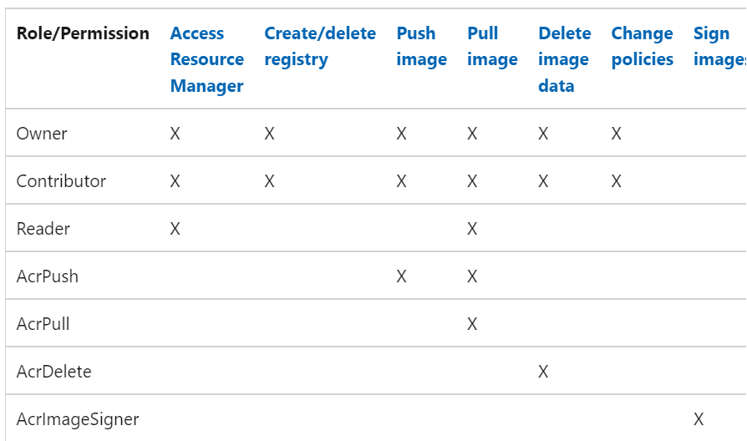

Slide 11
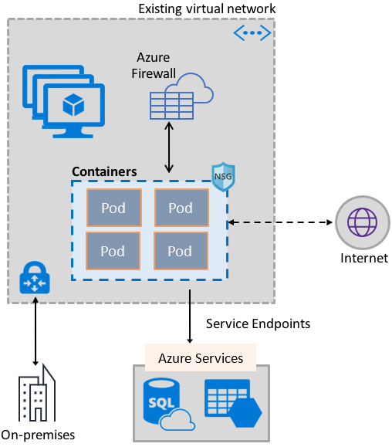
Your Company’s Azure subscription includes a virtual network that has a single subnet configured. You have created a service endpoint for the subnet, which includes an Azure virtual machine that has Ubuntu Server 18.04 installed. You are preparing to deploy Docker containers to the virtual machine. You need to make sure that the containers can access Azure Storage resources and Azure SQL databases via the service endpoint. You need to perform a task on the virtual machine prior to deploying containers.
Solution: You install the container network interface (CNI) plug-in
Azure Virtual Network container network interface (CNI) plug-in installs in an Azure Virtual Machine. The plug-in supports both Linux and Windows platform. The plug-in assigns IP addresses from a virtual network to containers brought up in the virtual machine, attaching them to the virtual network, and connecting them directly to other containers and virtual network resources. The plug-in doesn גTM€t rely on overlay networks, or routes, for connectivity, and provides the same performance as virtual machines. The following picture shows how the plug-in provides Azure Virtual Network capabilities to Pods:

Slide 12
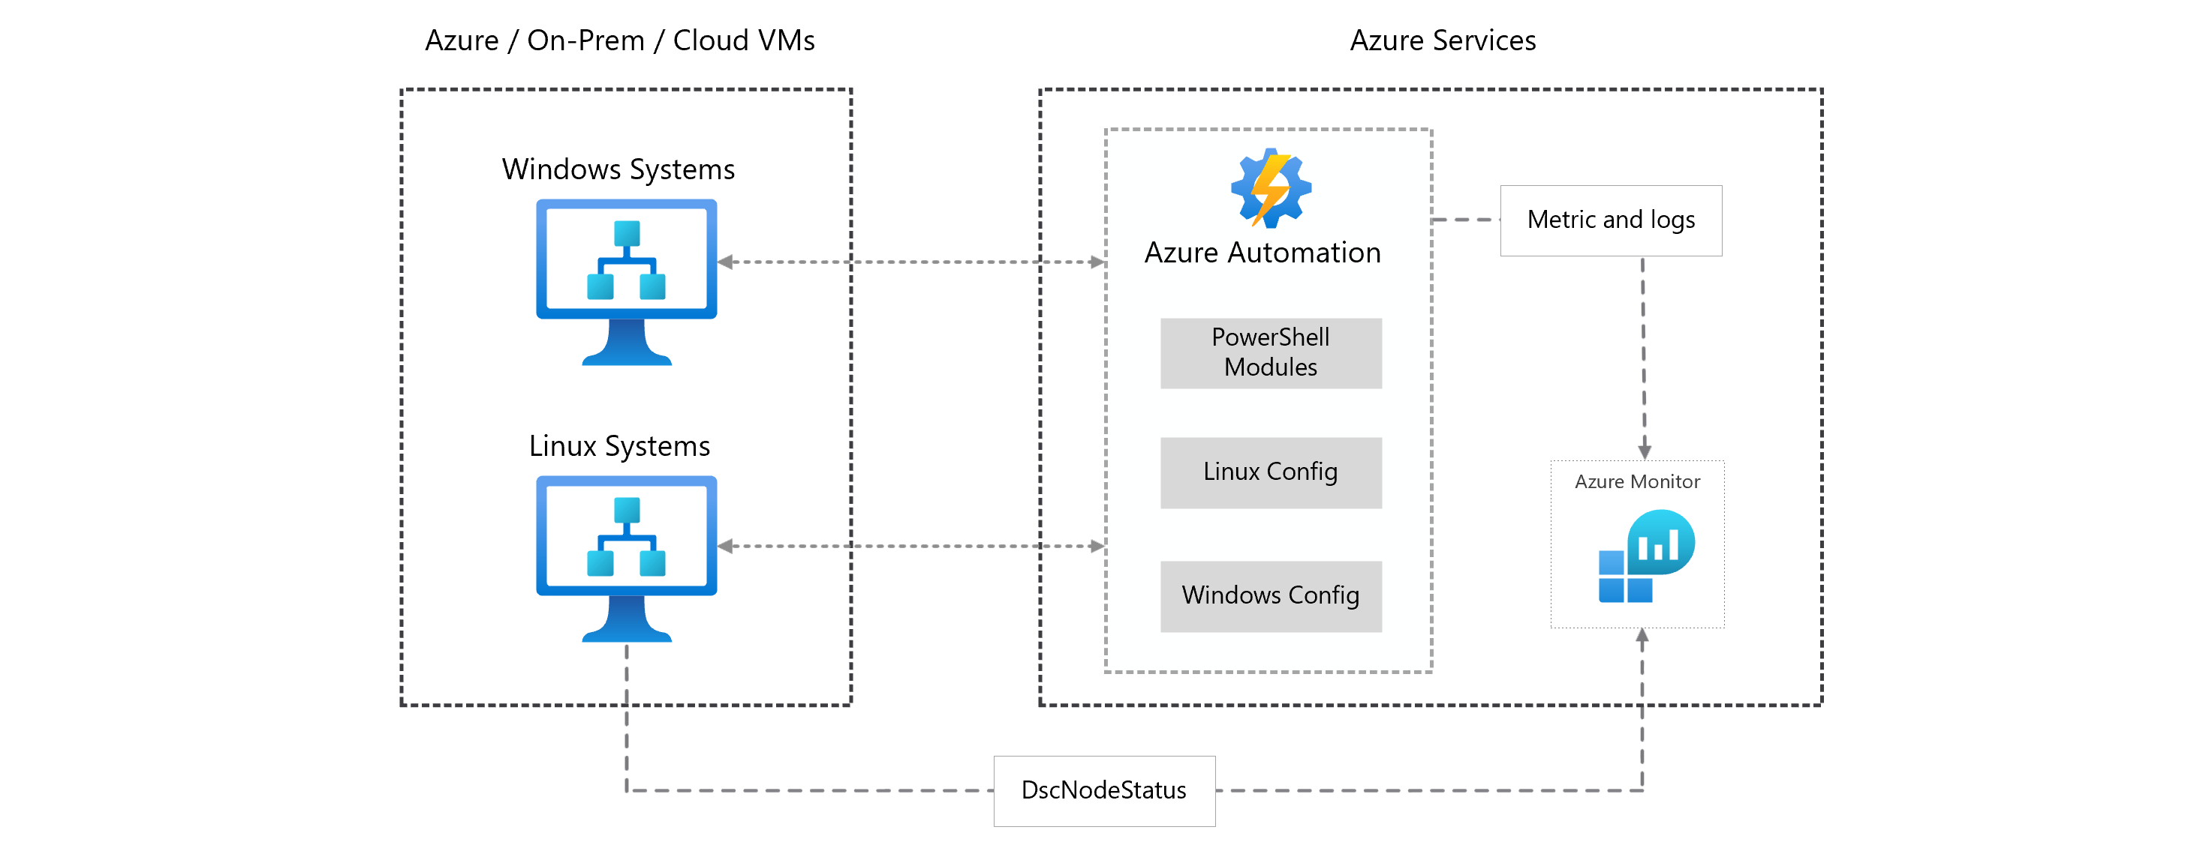
You make use of Azure Resource Manager templates to deploy Azure virtual machines. You have been tasked with making sure that Windows features that are not in use, are automatically inactivated when instances of the virtual machines are provisioned. Which of the following actions should you take?
You should make use of Azure Automation State Configuration
You can use Azure Automation State Configuration to manage Azure VMs (both Classic and Resource Manager), on-premises VMs, Linux machines, AWS VMs, and on-premises physical machines.
Note: Azure Automation State Configuration provides a DSC pull server similar to the Windows Feature DSC-Service so that target nodes automatically receive configurations, conform to the desired state, and report back on their compliance. The built-in pull server in Azure Automation eliminates the need to set up and maintain your own pull server. Azure Automation can target virtual or physical Windows or Linux machines, in the cloud or on-premises.
configuration windowsfeatures {
Import-DscResource -ModuleName PsDesiredStateConfiguration
node localhost {
WindowsFeature WebServer {
Ensure = "Present"
Name = "Web-Server"
}
}
}
az deployment group create --resource-group state-configuration \
--template-uri https://raw.githubusercontent.com/mspnp/samples/master/solutions/azure-automation-state-configuration/azuredeploy.json

Slide 13
Your company גTM€s Azure subscription includes Windows Server 2016 Azure virtual machines. You are informed that every virtual machine must have a custom antimalware virtual machine extension installed. You are writing the necessary code for a policy that will help you achieve this. Which of the following is an effect that must be included in your code?
DeployIfNotExists
Explanation: DeployIfNotExists executes a template deployment when the condition is met
Effects currently supported in a policy definition:
Append
Audit
AuditIfNotExists
Deny
DeployIfNotExists
Disabled
Manual (preview)
Modify

Slide 14
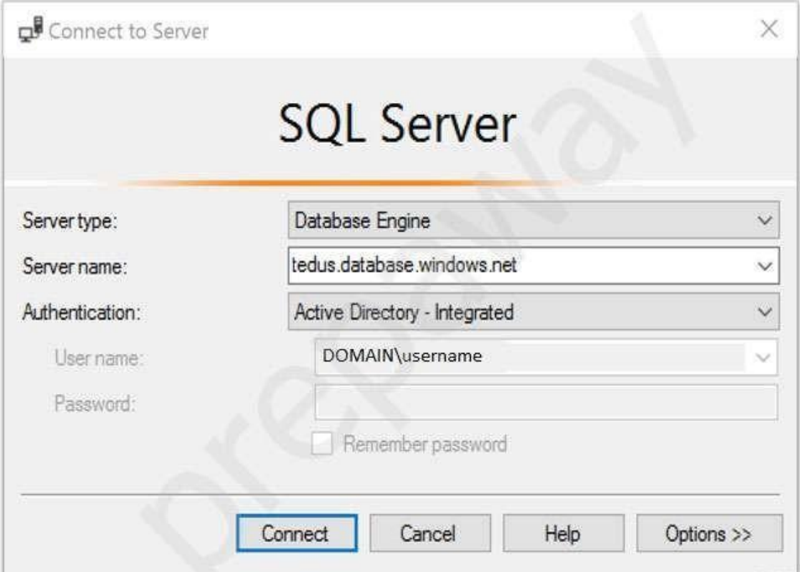
Your company makes use of Azure Active Directory (Azure AD) in a hybrid configuration. All users are making use of hybrid Azure AD joined Windows 10 computers. You manage an Azure SQL database that allows for Azure AD authentication. You need to make sure that database developers are able to connect to the SQL database via Microsoft SQL Server Management Studio (SSMS). You also need to make sure the developers use their on-premises Active Directory account for authentication. Your strategy should allow for authentication prompts to be kept to a minimum. Which of the following is the authentication method the developers should use?
Active Directory integrated authentication
Azure AD can be the initial Azure AD managed domain. Azure AD can also be an on-premises Active Directory Domain Services that is federated with the Azure AD. Using an Azure AD identity to connect using SSMS or SSDT The following procedures show you how to connect to a SQL database with an Azure AD identity using SQL Server Management Stud io or SQL Server Database Tools. Active Directory integrated authentication Use this method if you are logged in to Windows using your Azure Active Directory credentials from a federated domain.
Start Management Studio or Data Tools and in the Connect to Server (or Connect to Database Engine) dialog box, in the Authentication box, select Active Directory - Integrated. No password is needed or can be entered because your existing credentials will be presented for the connection.
Select the Options button, and on the Connection Properties page, in the Connect to database box, type the name of the user database you want to connect to. (The AD domain name or tenant IDג €option is only supported for Universal with MFA connection options, otherwise it is greyed out.)

Slide 15
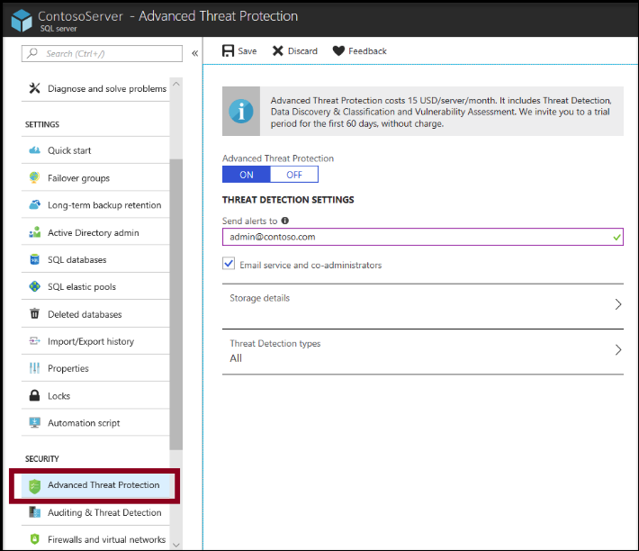
You have been tasked with enabling Advanced Threat Protection for an Azure SQL Database server. Advanced Threat Protection must be configured to identify all types of threat detection. Which of the following will happen if when a faulty SQL statement is generate in the database by an application?
- A Vulnerability to SQL injection alert is triggered.

Slide 16
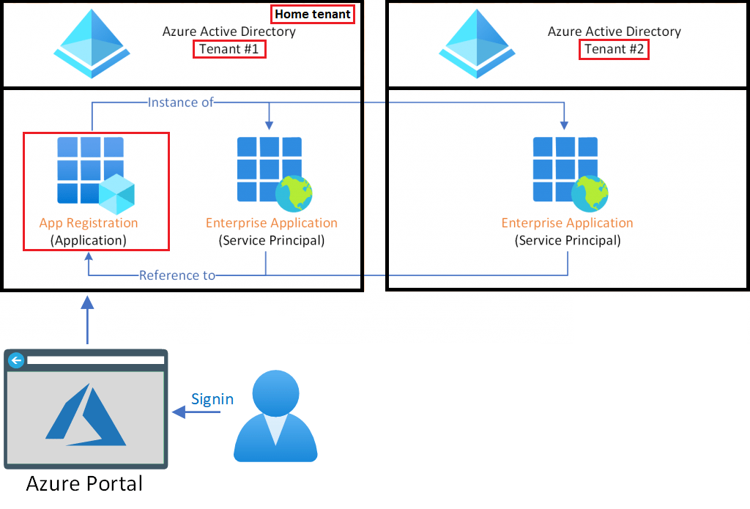
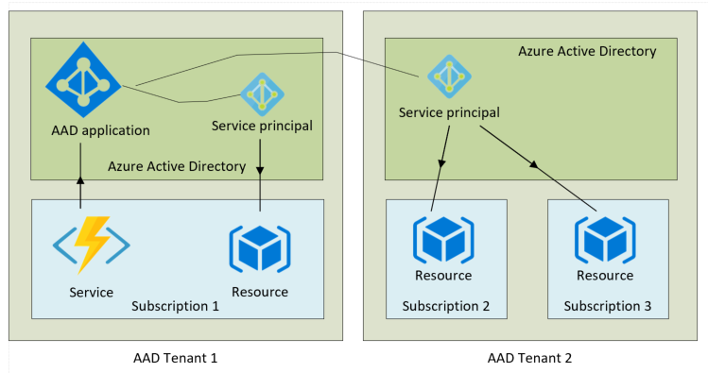
Establish a solution that satisfies the requirements. You are in the process of creating an Azure Kubernetes Service (AKS) cluster. The Azure Kubernetes Service (AKS) cluster must be able to connect to an Azure Container Registry. You want to make sure that Azure Kubernetes Service (AKS) cluster authenticates to the Azure Container Registry by making use of the auto-generated service principal.
Solution: You create an Azure Active Directory (Azure AD) role assignment
When you create an AKS cluster, Azure also creates a service principal to support cluster operability with other Azure resources. You can use this auto-generated service principal for authentication with an ACR registry. To do so, you need to create an Azure AD role assignment that grants the cluster's service principal access to the container registry.

Slide 17
Your company has an Azure subscription that includes two virtual machines, named VirMac1 and VirMac2, which both have a status of Stopped (Deallocated). The virtual machines belong to different resource groups, named ResGroup1 and ResGroup2. You have also created two Azure policies that are both configured with the virtualMachines resource type. The policy configured for ResGroup1 has a policy definition of Not allowed resource types, while the policy configured for ResGroup2 has a policy definition of Allowed resource types. You then create a Read-only resource lock on VirMac1, as well as a Read-only resource lock on ResGroup2. Following would be TRUE with regards to the scenario:
- You will NOT be able to start VirMac1.
You will NOT be able to create a virtual machine in ResGroup2
In Azure Policy, we offer several built-in policies that are available by default. For example:
Allowed Storage Account SKUs (Deny): Determines if a storage account being deployed is within a set of SKU sizes. Its effect is to deny all storage accounts that don't adhere to the set of defined SKU sizes.
Allowed Resource Type (Deny): Defines the resource types that you can deploy. Its effect is to deny all resources that aren't part of this defined list.
Allowed Locations (Deny): Restricts the available locations for new resources. Its effect is used to enforce your geo-compliance requirements.
Allowed Virtual Machine SKUs (Deny): Specifies a set of virtual machine SKUs that you can deploy.
Add a tag to resources (Modify): Applies a required tag and its default value if it's not specified by the deploy request.
Not allowed resource types (Deny): Prevents a list of resource types from being deployed.

Slide 18
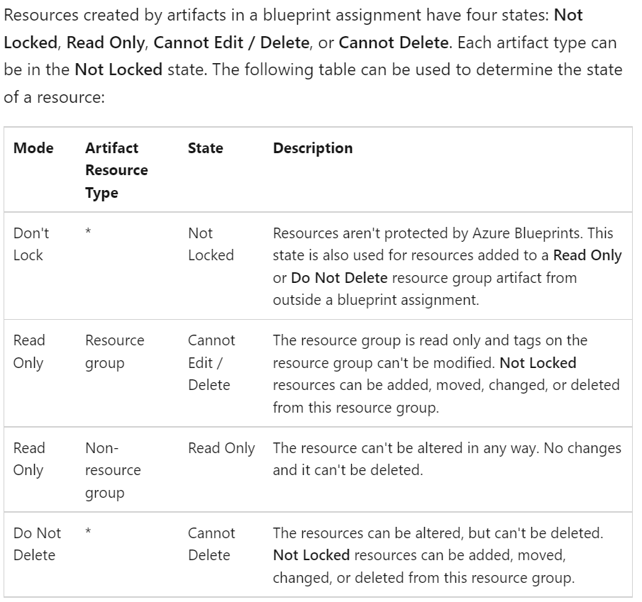

Slide 19
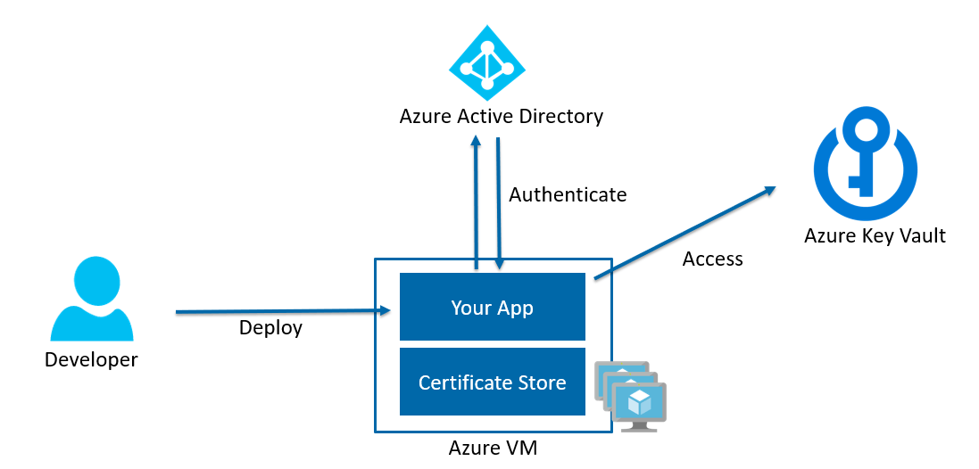
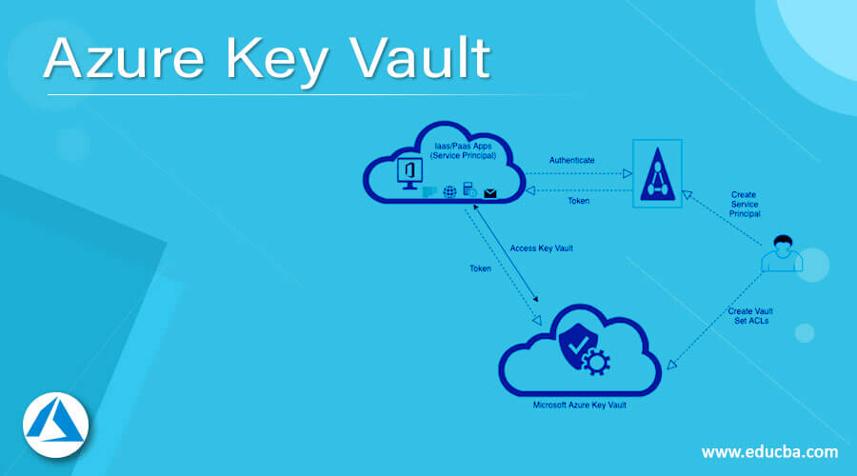
You have been tasked with delegate administrative access to your company גTM€s Azure key vault. You have to make sure that a specific user can set advanced access policies for the key vault. You also have to make sure that access is assigned based on the principle of least privilege. Which of the following options should you use to achieve your goal?
RBAC
Next - You have to make sure that a specific user is able to add and delete certificates in the key vault. You also have to make sure that access is assigned based on the principle of least privilege. Which of the following options should you use to achieve your goal?
A key vault access policy

Slide 20
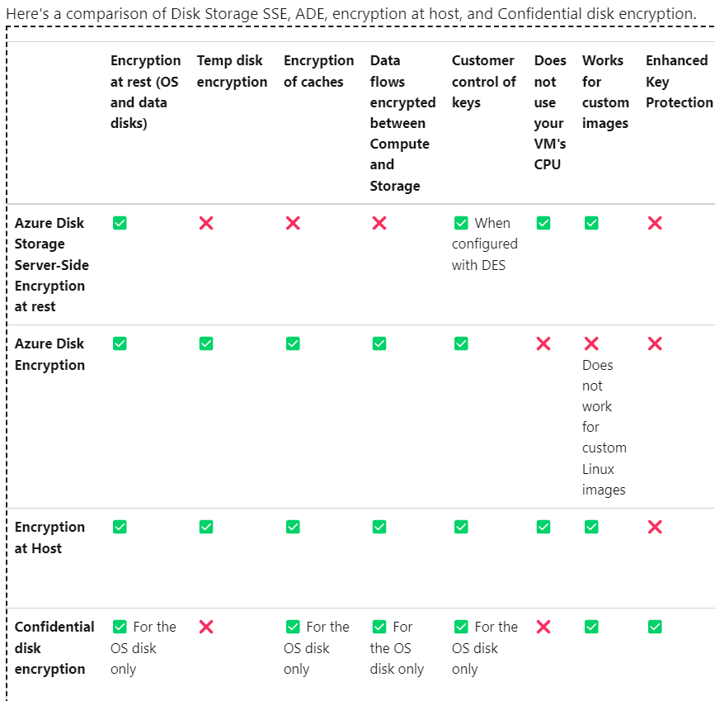
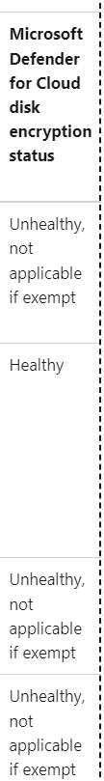
You have an Azure virtual machine that runs Windows Server R2. You plan to deploy and configure an Azure Key vault and enable Azure Disk Encryption for the virtual machine. Which of the following is TRUE with regards to Azure Disk Encryption for a Windows VM?
- It is supported for standard tier VMs.
You have an Azure virtual machine that runs Ubuntu 16.04-DAILY-LTS. You plan to deploy and configure an Azure Key vault and enable Azure Disk Encryption for the virtual machine. Which of the following is TRUE with regards to Azure Disk Encryption for a Linux VM?
- It is NOT supported for basic tier VMs.

Slide 21
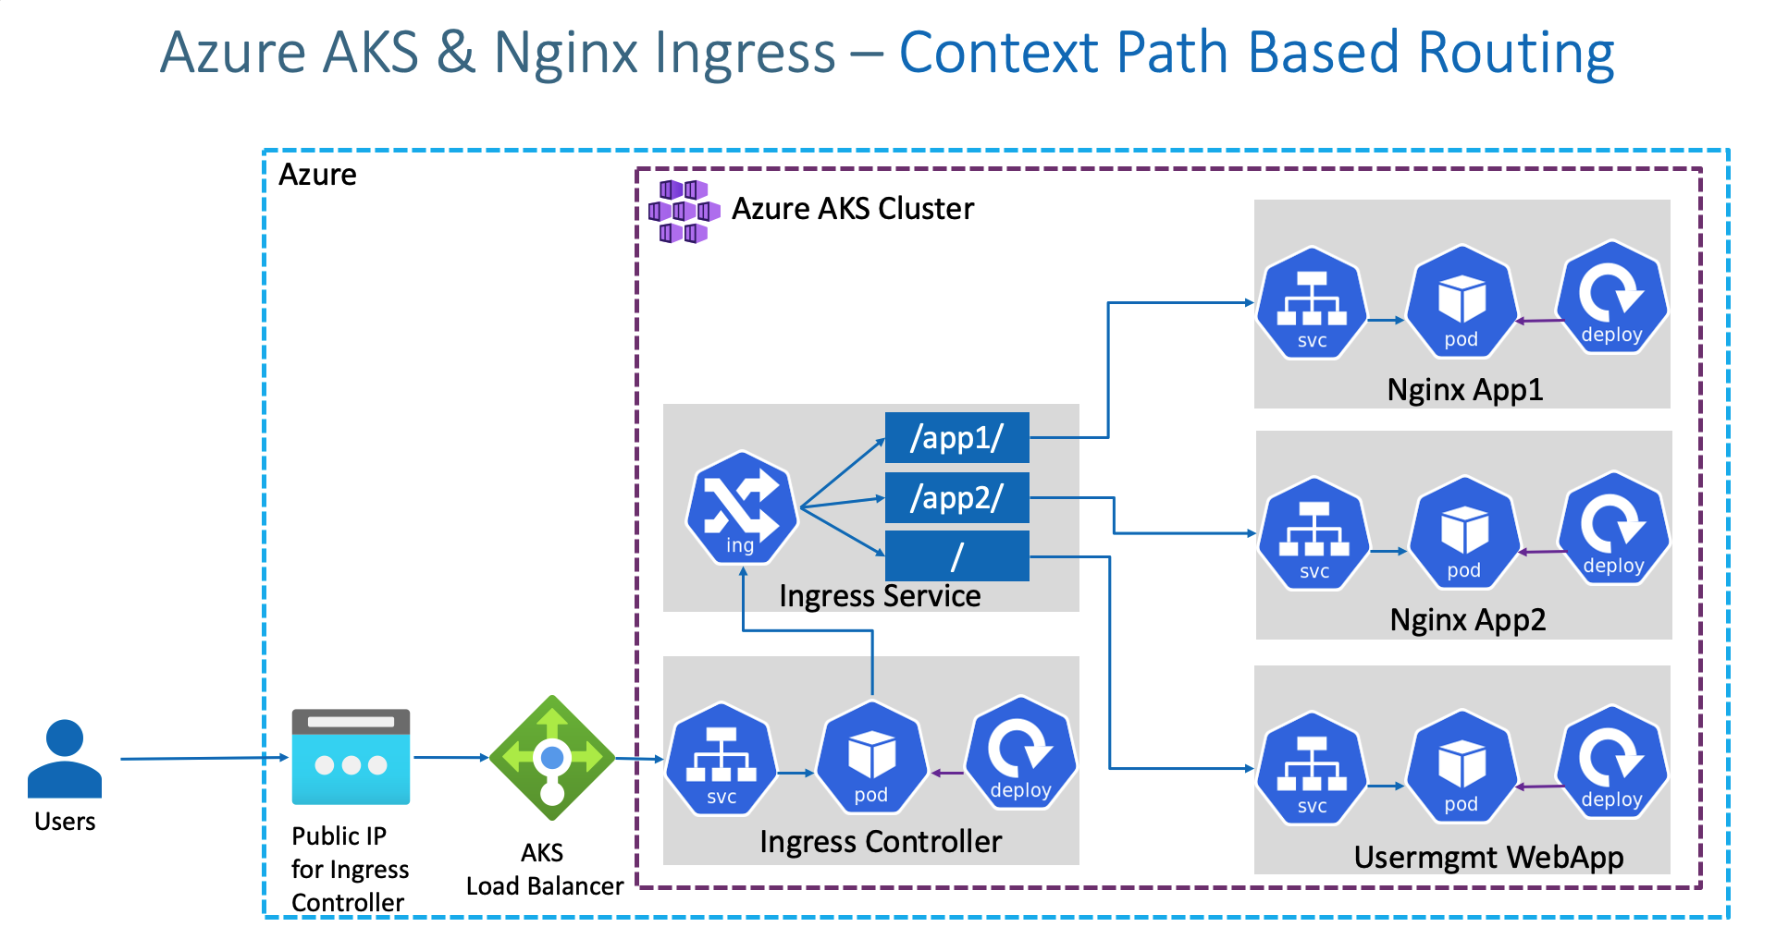
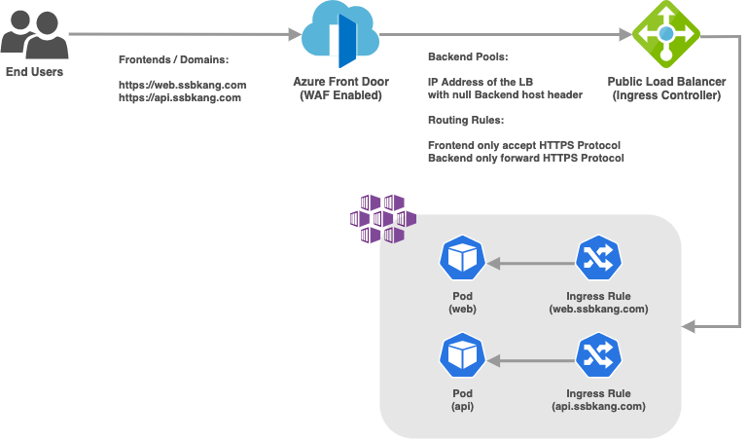
You have configured an Azure Kubernetes Service (AKS) cluster in your testing environment. You are currently preparing to deploy the cluster to the production environment. After disabling HTTP application routing, you want to replace it with an application routing solution that allows for reverse proxy and TLS termination for AKS services via a solitary IP address. You must create an AKS Ingress controller. select the accurate option.
No adjustment required.
Note: An ingress controller is a piece of software that provides reverse proxy, configurable traffic routing, and TLS termination for Kubernetes services

Slide 22
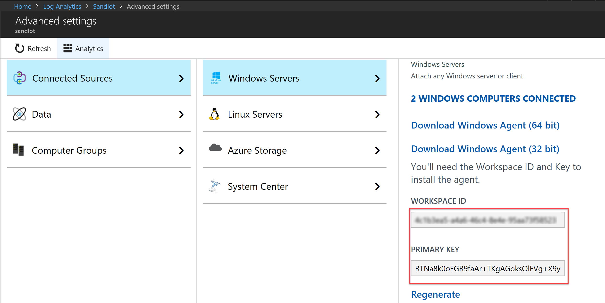
You want to gather logs from a large number of Windows Server 2016 computers using Azure Log Analytics. You are configuring an Azure Resource Manager template to deploy the Microsoft Monitoring Agent to all the servers automatically. Which of the following should be included in the template?
- WorkspaceID
- WorkspaceKey

Slide 23
Your company has Azure subscription linked to their Azure Active Directory (Azure AD) tenant. As a Global administrator for the tenant, part of your responsibilities involves managing Azure Security Center settings. You are currently preparing to create a custom sensitivity label.
- First you have to create a custom sensitive information type.
Here is the documentation:
1- Create Sensitive Info type
2- Create Pattern
3- Choose Confidence level
4- Choose and define primary elements
5- Value for char prox
6- Choose recommend confidence level
7 - Submit

Slide 24
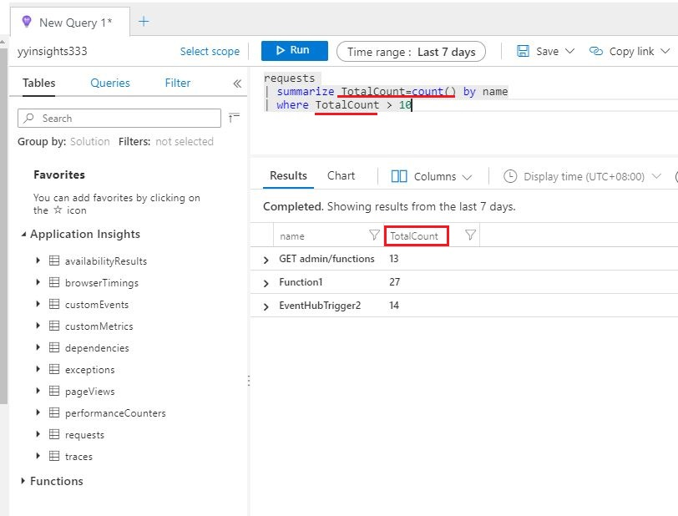
You have a sneaking suspicion that there are users trying to sign in to resources which are inaccessible to them. You decide to create an Azure Log Analytics query to confirm your suspicions. The query will detect unsuccessful user sign-in attempts from the last few days. You want to make sure that the results only show users who had failed to sign-in more than five times. Which of the following should be included in your query?
- EventID and Count() parameters.

Slide 25
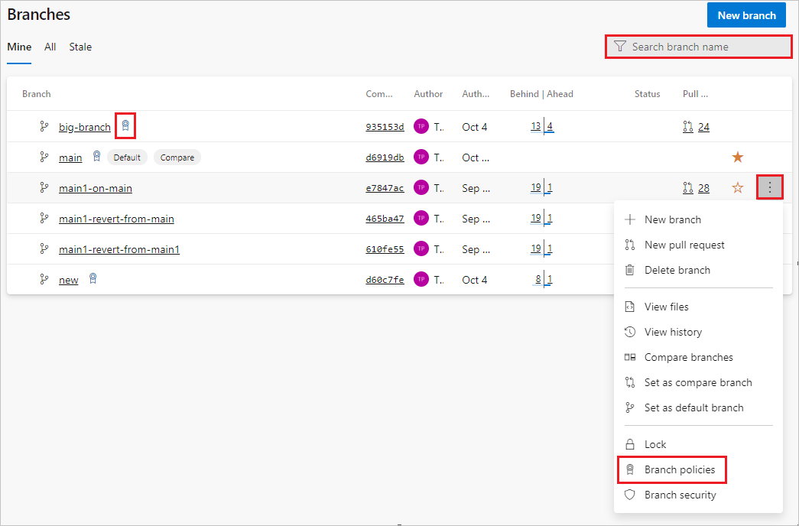
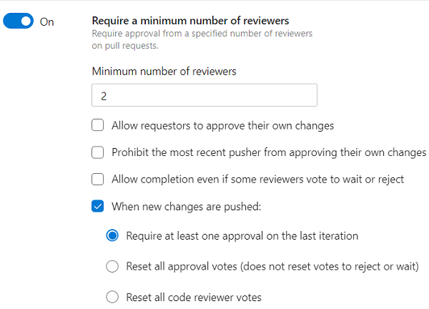
Your company uses Azure DevOps with branch policies configured. Which of the following is TRUE with regards to branch policies? (Choose all that apply.)
- It enforces your team's change management standards
- It enforces your team's code quality.
Branch policies help teams protect their important branches of development. Policies enforce your team's code quality and change management standards.

Slide 26
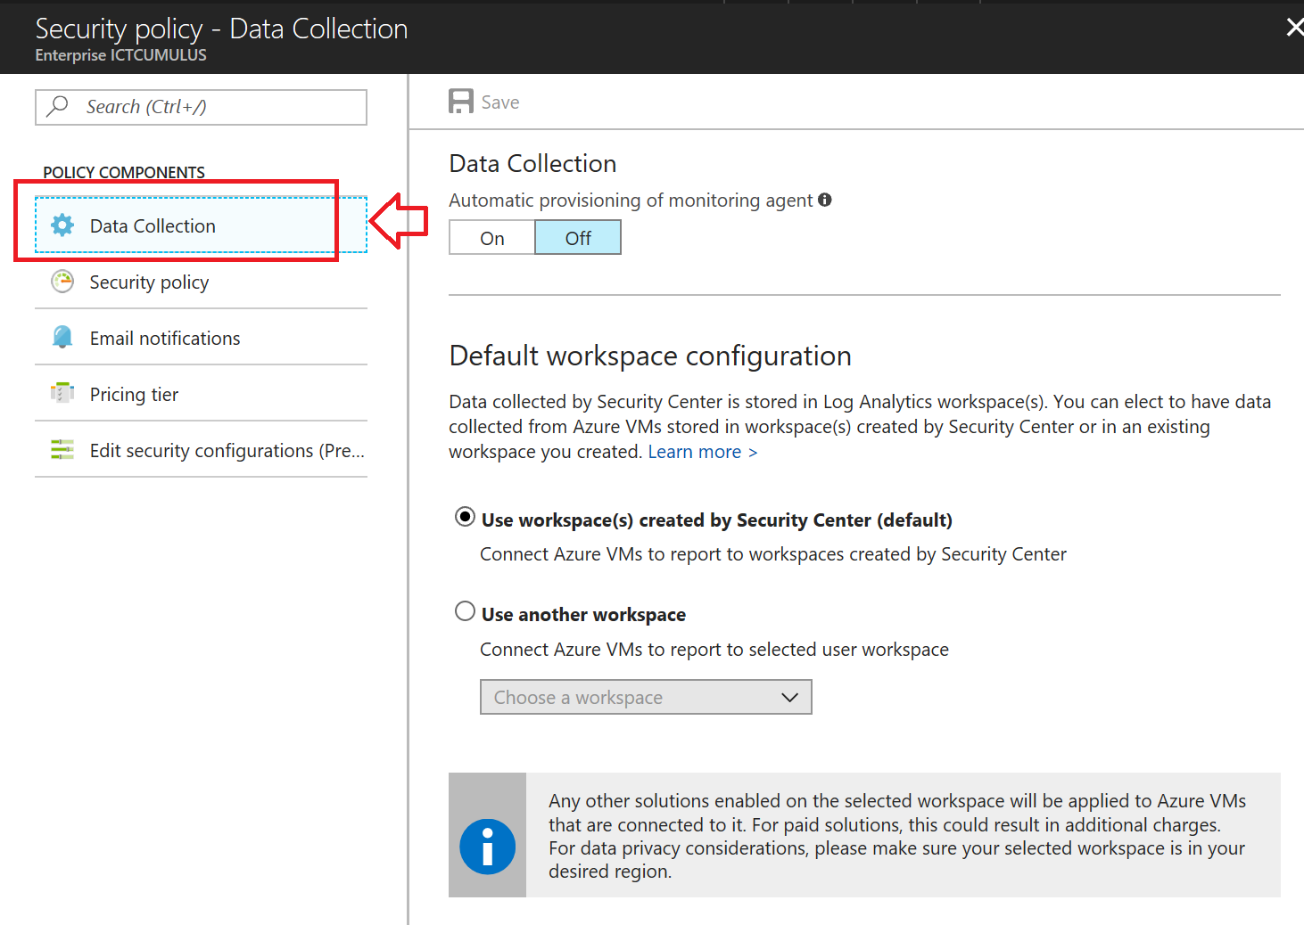
After creating a new Azure subscription, you are tasked with making sure that custom alert rules can be created in Azure Security Center. You have created an Azure Storage account. Which of the following is the action you should take?
-You should create an Azure Log Analytics workspace
You need write permission in the workspace that you select to store your custom alert.

Slide 27
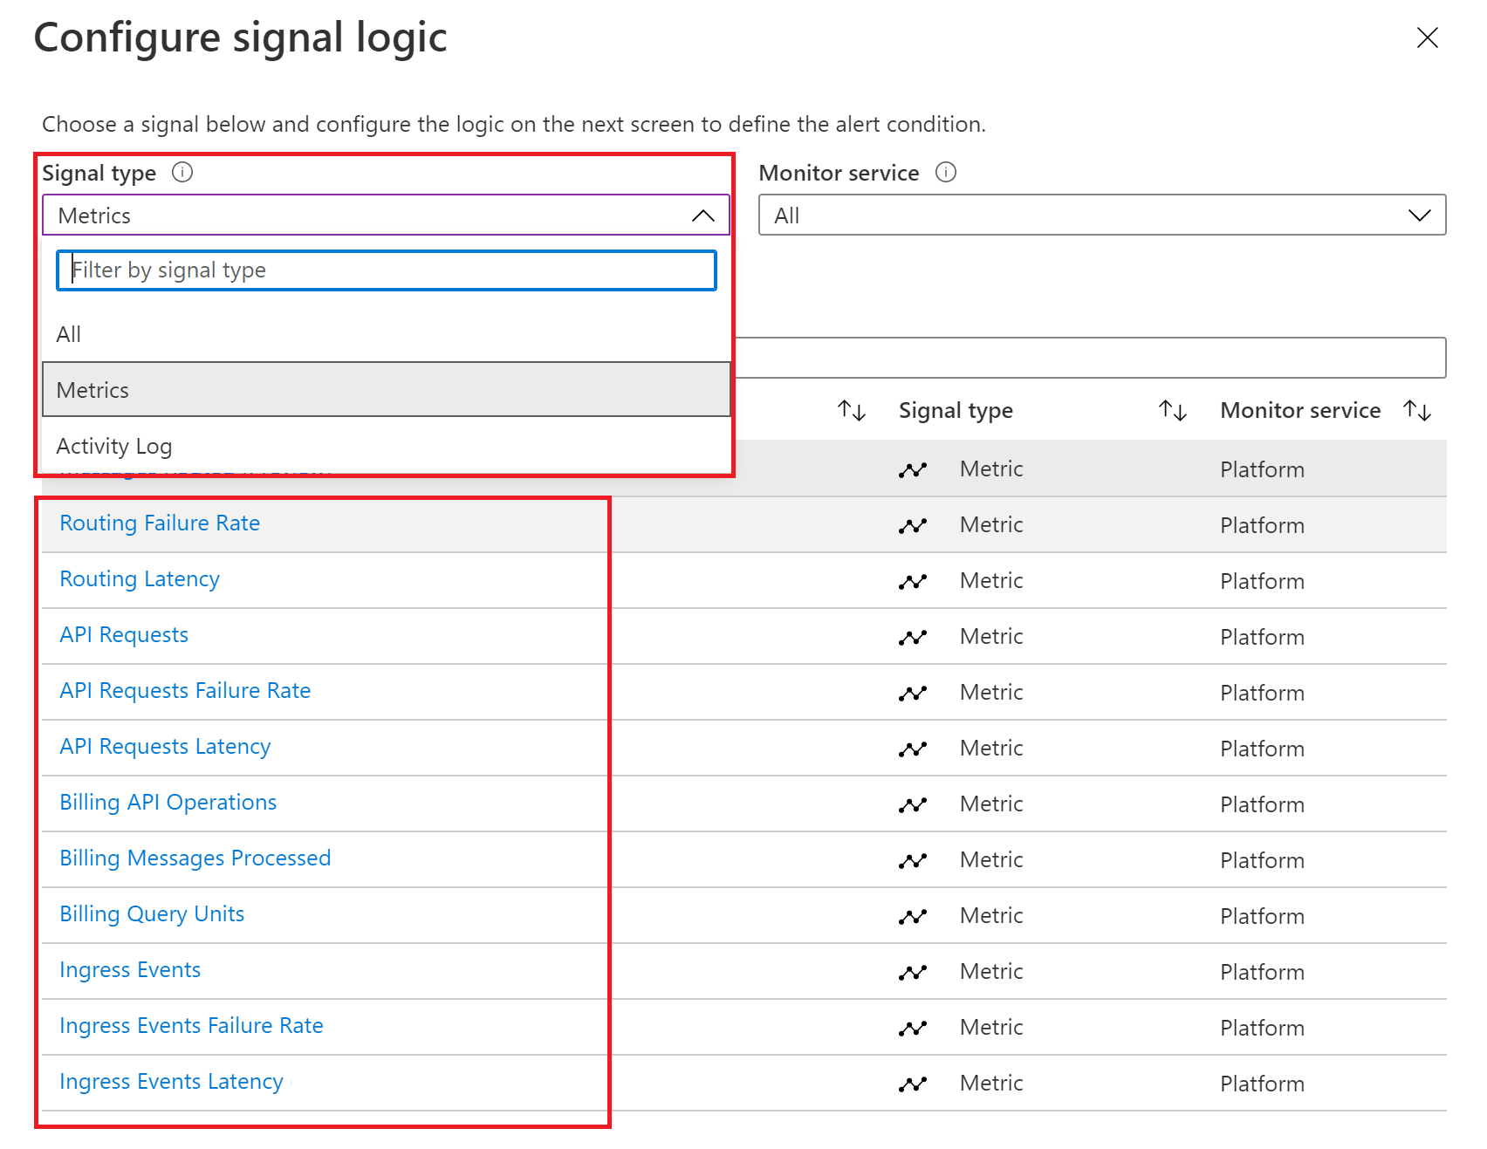
Your company גTM€s Azure subscription includes an Azure Log Analytics workspace. Your company has a hundred on-premises servers that run either Windows Server 2012 R2 or Windows Server 2016, and is linked to the Azure Log Analytics workspace. The Azure Log Analytics workspace is set up to gather performance counters associated with security from these linked servers. You have been tasked with configuring alerts according to the information gathered by the Azure Log Analytics workspace. You have to make sure that alert rules allow for dimensions, and that alert creation time should be kept to a minimum. Furthermore, a single alert notification must be created when the alert is created and when the alert is sorted out. You need to make use of the necessary signal type when creating the alert rules. Which of the following is the option you should use?
You should make use of the Metric signal type.
Metric alerts in Azure Monitor provide a way to get notified when one of your metrics cross a threshold. Metric alerts work on a range of multi-dimensional platform metrics, custom metrics, Application Insights standard and custom metrics. Note: Signals are emitted by the target resource and can be of several types. Metric, Activity log, Application Insights, and Log.

Slide 28
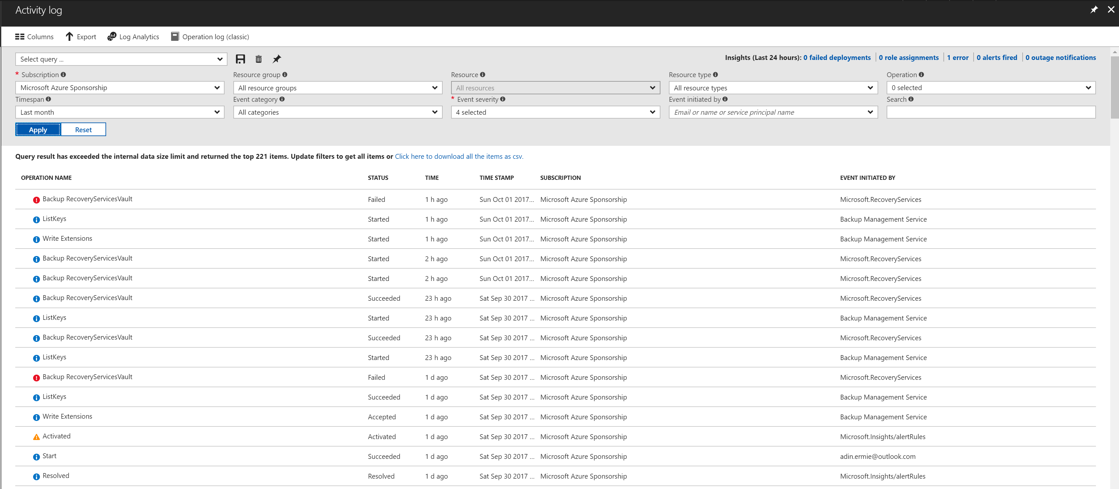
Your company גTM€s Azure subscription includes a hundred virtual machines that have Azure Diagnostics enabled. You have been tasked with retrieving the identity of the user that removed a virtual machine fifteen days ago. You have already accessed Azure Monitor. Which of the following options should you use?
-Activity Log
Azure activity logs provide insight into the operations that were performed on resources in your subscription. Activity logs were previously known as ג€audit logs ג €or ג€operational logs, ג €because they report control-plane events for your subscriptions.

Slide 29
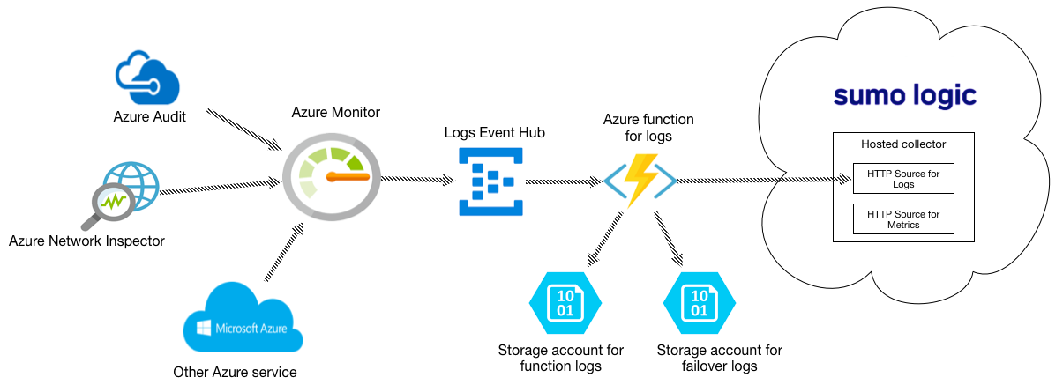
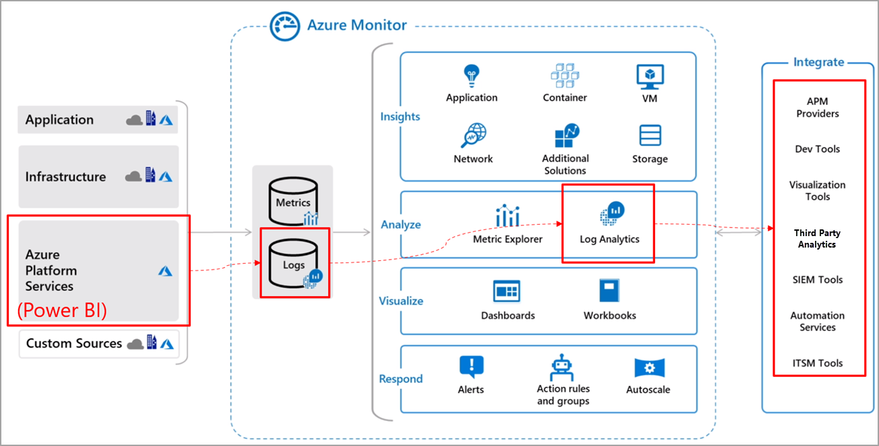
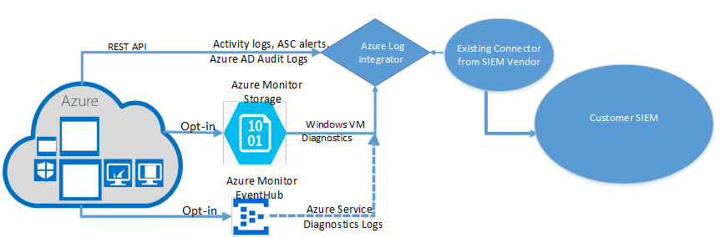
Your company גTM€s Azure subscription includes a hundred virtual machines that have Azure Diagnostics enabled. You have been tasked with analyzing the security events of a Windows Server 2016 virtual machine. You have already accessed Azure Monitor. Which of the following options should you use?
-Logs
Explanation: Log Integration collects Azure diagnostics from your Windows virtual machines, Azure activity logs, Azure Security Center alerts, and Azure resource provider logs. This integration provides a unified dashboard for all your assets, whether they're on-premises or in the cloud, so that you can aggregate, correlate, analyze, and alert for security events.

Slide 30
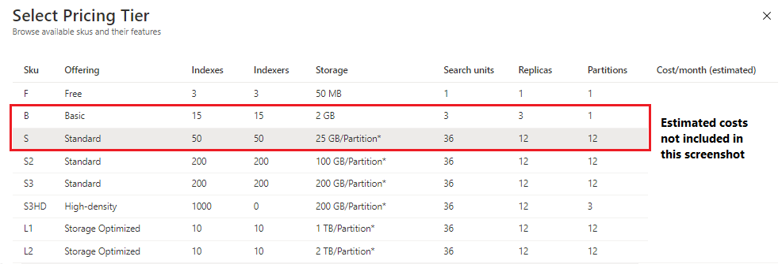
You have been tasked with making sure that you are able to modify the operating system security configurations via Azure Security Center. To achieve your goal, you need to have the correct pricing tier for Azure Security Center in place. Which of the following is the pricing tier required?
-Standard

Slide 31
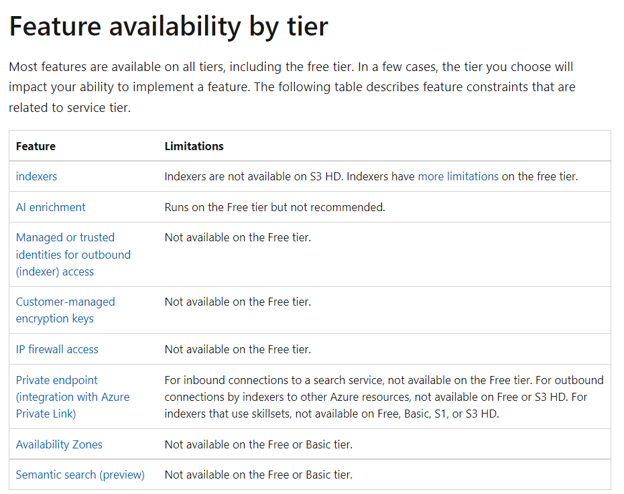

Slide 32
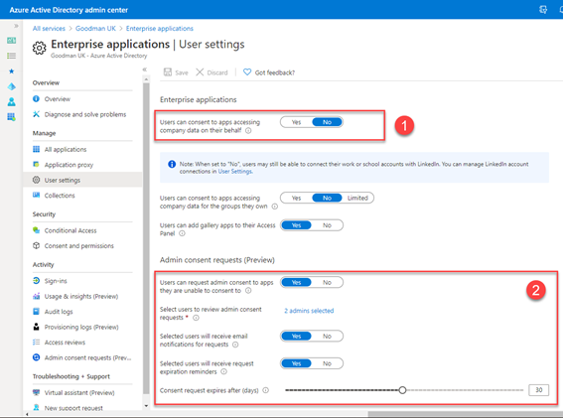
Your company גTM€s Azure subscription is linked to their Azure Active Directory (Azure AD) tenant. After an internally developed application is registered in Azure AD, you are tasked with making sure that the application has the ability to access Azure Key Vault secrets on application the users ג TM€behalf.
Solution: You configure a delegated permission with no admin consent.
Explanation: Delegated permissions - Your client application needs to access the web API as the signed-in user, but with access limited by the selected permission. This type of permission can be granted by a user unless the permission requires administrator consent.

Slide 33
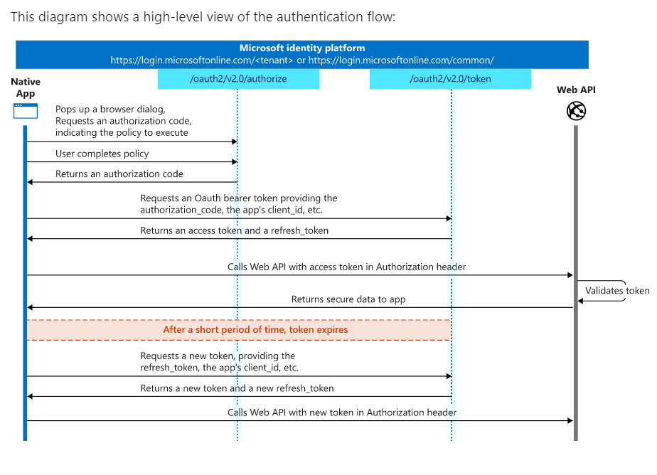
Your Azure Active Directory Azure (Azure AD) tenant has an Azure subscription linked to it. Your developer has created a mobile application that obtains Azure AD access tokens using the OAuth 2 implicit grant type. The mobile application must be registered in Azure AD. You require a redirect URI from the developer for registration purposes.
Explanation: For Native Applications you need to provide a Redirect URI, which Azure AD will use to return token responses.

Slide 34
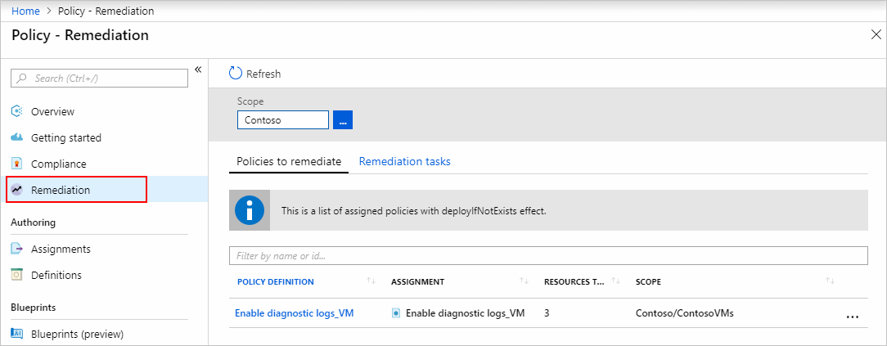
You are in the process of configuring an Azure policy via the Azure portal. Your policy will include an effect that will need a managed identity for it to be assigned. Which of the following is the effect in question?
C. DeployIfNotExist
Explanation: When Azure Policy runs the template in the deployIfNotExists policy definition, it does so by using a managed identity.

Slide 35
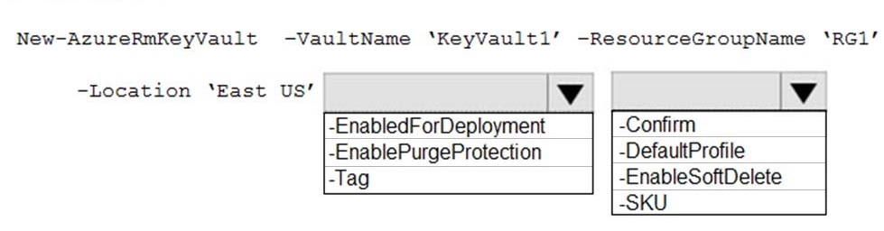
You have been tasked with creating an Azure key vault using PowerShell. You have been informed that objects deleted from the key vault must be kept for a set period of 90 days. Which two of the following parameters must be used in conjunction to meet the requirement?
EnablePurgeProtection
EnableSoftDelete

Slide 36
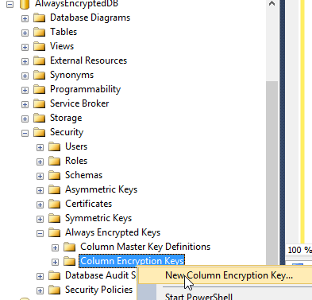
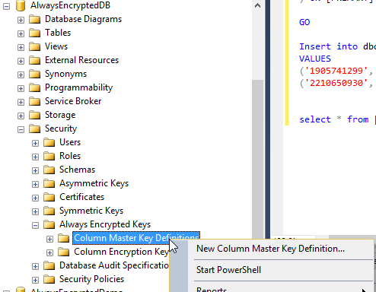
You are required to make the relevant information available to application developers to allow them to access data in the database. Which two of the following options should be made available?
Always Encrypted uses two types of keys: column encryption keys and column master keys.
A column encryption key is used to encrypt data in an encrypted column. A column master key is a key-protecting key that encrypts one or more column encryption keys.

Slide 37
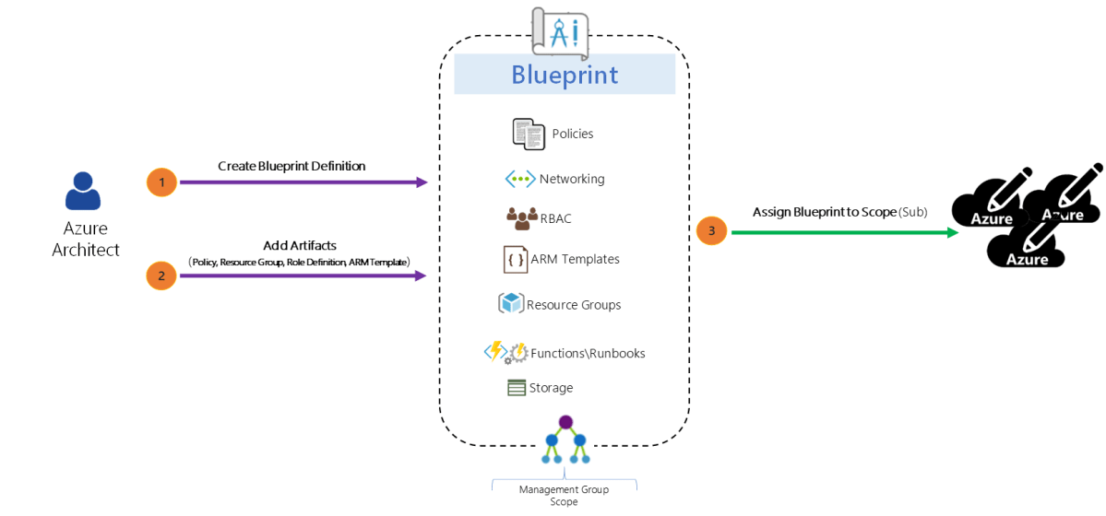
Just as a blueprint allows an engineer or an architect to sketch a project's design parameters, Azure Blueprints enables cloud architects and central information technology groups to define a repeatable set of Azure resources that implements and adheres to an organization's standards, patterns, and requirements. Blueprints are a declarative way to orchestrate the deployment of various resource templates and other artifacts such as: ✑ Role Assignments ✑ Policy Assignments ✑ Azure Resource Manager templates ✑ Resource Groups

Slide 38
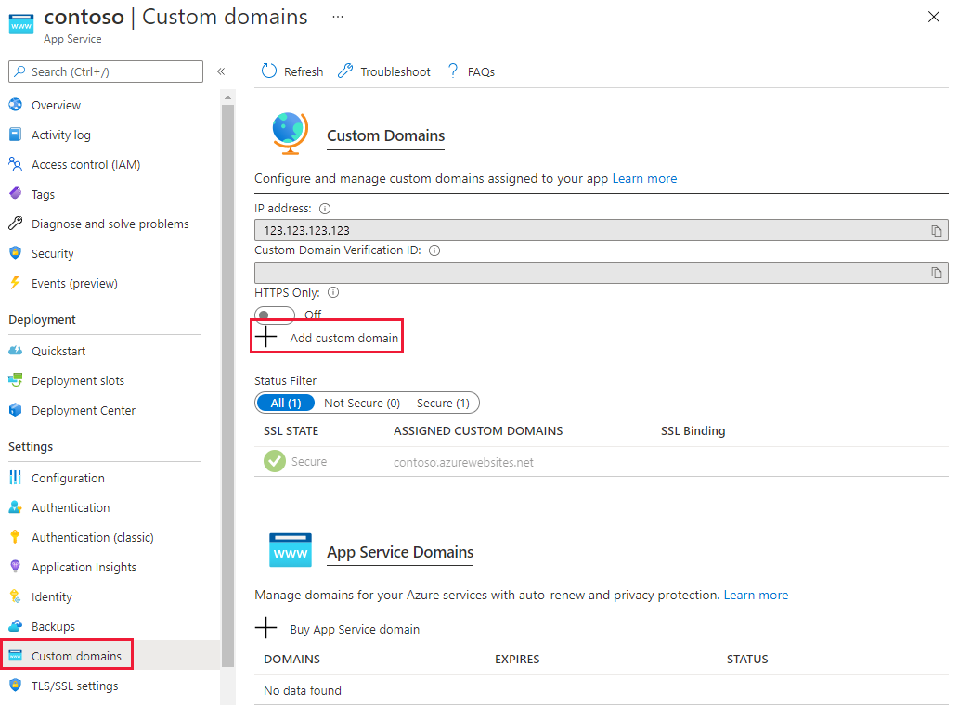
- You can configure Azure DNS to host a custom domain for your web apps. For example, you can create an Azure web app and have your users access it using either www.contoso.com or contoso.com as a fully qualified domain name (FQDN). To do this, you must create three records: A root "A" record pointing to contoso.com A root "TXT" record for verification A "CNAME" record for the www name that points to the A record - To use HTTPS, you need to upload a PFX file to the Azure Web App. The PFX file will contain the SSL certificate required for HTTPS.

Slide 39
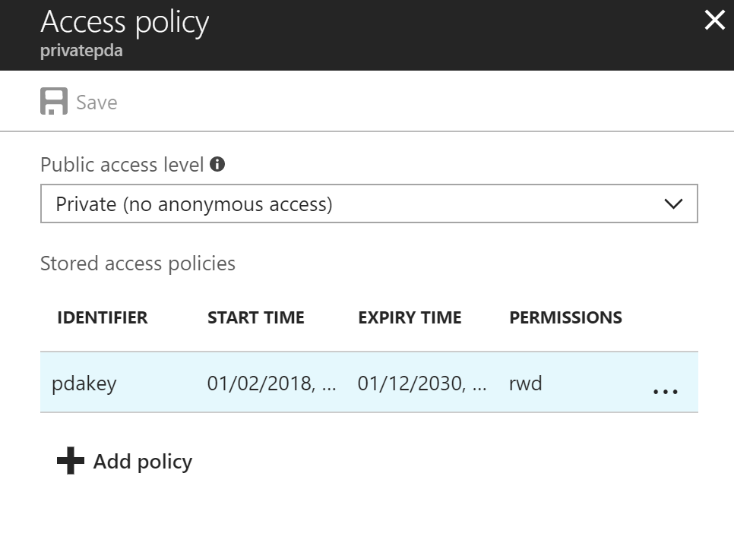
To revoke a stored access policy, you can either delete it, or rename it by changing the signed identifier. Changing the signed identifier breaks the associations between any existing signatures and the stored access policy. Deleting or renaming the stored access policy immediately affects all of the shared access signatures associated with it.

Slide 40
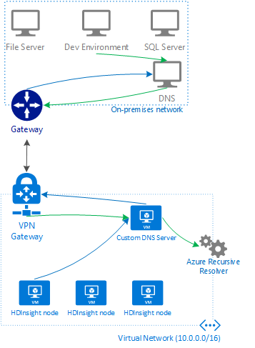
If you connect HDInsight to your on-premises network by using Azure Virtual Networks and a VPN gateway. Note: To allow HDInsight and resources in the joined network to communicate by name, you must perform the following actions: ✑ Create Azure Virtual Network. ✑ Create a custom DNS server in the Azure Virtual Network. ✑ Configure the virtual network to use the custom DNS server instead of the default Azure Recursive Resolver. ✑ Configure forwarding between the custom DNS server and your on-premises DNS server.

Slide 41
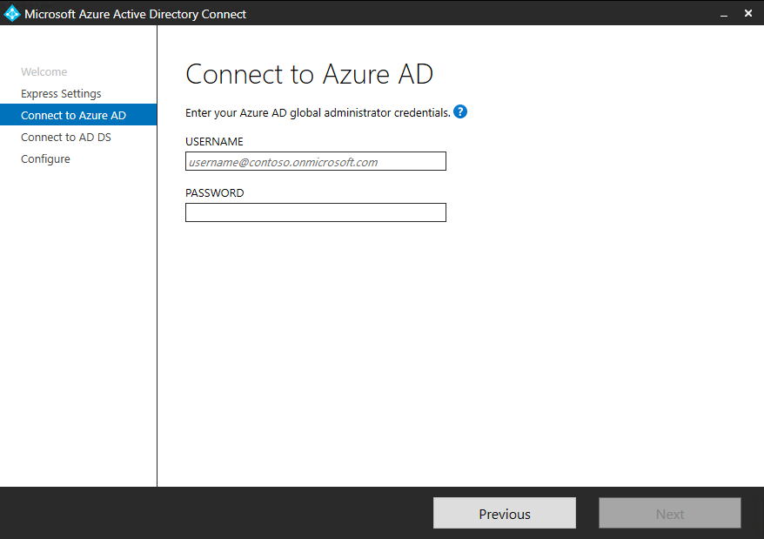
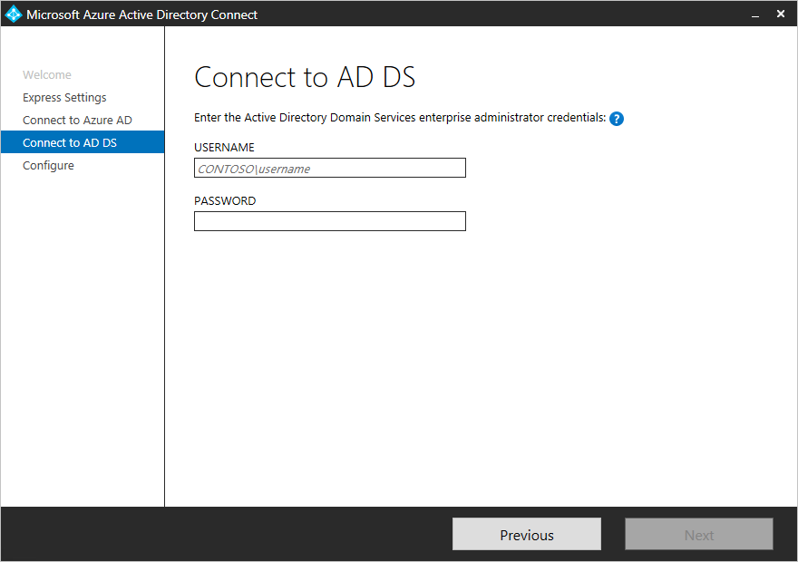
Your network contains an Active Directory forest named contoso.com. You have an Azure Active Directory (Azure AD) tenant named contoso.com. You plan to configure synchronization by using the Express Settings installation option in Azure AD Connect. You need to identify which roles and groups are required to perform the planned configuration. The solution must use the principle of least privilege. Which two roles and groups should you identify?
- the Global administrator role in Azure AD
- the Enterprise Admins group in Active Directory

Slide 42
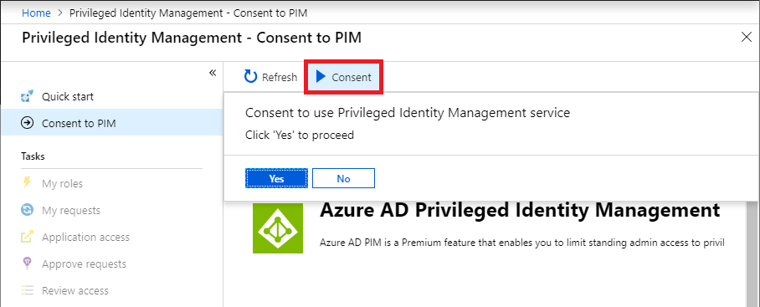
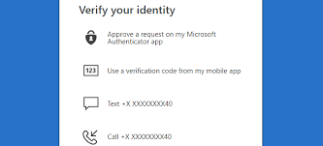

You create an Azure subscription with Azure AD Premium P2. You need to ensure that you can use Azure Active Directory (Azure AD) Privileged Identity Management (PIM) to secure Azure AD roles. Which three actions should you perform in sequence?
Step: 1 Consent to PIM
Step: 2 Verify your identity by using multi-factor authentication (MFA) Click Verify my identity to verify your identity with Azure MF You'll be asked to pick an account. Step 3: Sign up PIM for Azure AD roles Once you have enabled PIM for your directory, you'll need to sign up PIM to manage Azure AD roles.

Slide 43

You have an Azure subscription named Sub1. You have an Azure Storage account named sa1 in a resource group named RG1. Users and applications access the blob service and the file service in sa1 by using several shared access signatures (SASs) and stored access policies. You discover that unauthorized users accessed both the file service and the blob service. You need to revoke all access to sa1.
- You regenerate the Azure storage account access keys.

Slide 44



You have an Azure Active Directory (Azure AD) tenant named contoso.com that contains the users shown in the following table.
Azure AD Privileged Identity Management (PIM) is used in contoso.com. In PIM, the Password Administrator role has the following settings: ✑ Maximum activation duration (hours): 2 ✑ Send email notifying admins of activation: Disable ✑ Require incident/request ticket number during activation: Disable ✑ Require Azure Multi-Factor Authentication for activation: Enable ✑ Require approval to activate this role: Enable ✑ Selected approver: Group1 You assign users the Password Administrator role as shown in the following table.
For each of the following statements, select Yes if the statement is true. Otherwise, select No.
Explanation: Box 1: Yes - Active assignments don't require the member to perform any action to use the role. Members assigned as active have the privileges assigned to the role at all times. Box 2: Yes - While Multi-Factor Authentication is disabled for User2 and the setting Require Azure Multi-Factor Authentication for activation is enabled, User2 can request the role but will need to enable MFA to use the role. Note: Eligible assignments require the member of the role to perform an action to use the role. Actions might include performing a multi-factor authentication (MFA) check, providing a business justification, or requesting approval from designated approvers.
Box 3: No - User3 is Group1, which is a Selected Approver Group, however, self-approval is not allowed and someone else from group is required to approve the request.

Slide 45


You have a hybrid configuration of Azure Active Directory (Azure AD) that has Single Sign-On (SSO) enabled. You have an Azure SQL Database instance that is configured to support Azure AD authentication. Database developers must connect to the database instance from the domain joined device and authenticate by using their on-premises Active Directory account. You need to ensure that developers can connect to the instance by using Microsoft SQL Server Management Studio. The solution must minimize authentication prompts. Which authentication method should you recommend?
- Active Directory – Integrated Details: Azure Active Directory Authentication is a mechanism of connecting to Microsoft Azure SQL Database by using identities in Azure Active Directory (Azure AD). Use this method for connecting to SQL Database if you are logged in to Windows using your Azure Active Directory credentials from a federated domain.

Slide 46

You plan to use Azure Resource Manager templates to perform multiple deployments of identically configured Azure virtual machines. The password for the administrator account of each deployment is stored as a secret in different Azure key vaults. You need to identify a method to dynamically construct a resource ID that will designate the key vault containing the appropriate secret during each deployment. The name of the key vault and the name of the secret will be provided as inline parameters. What should you use to construct the resource ID?
- a parameters file
Explanation: You reference the key vault in the parameter file, not the template. The following image shows how the parameter file references the secret and passes that value to the template.
az group deployment create --name acsenginedeploy -g sample-group --template-file azuredeploy.json --parameters @azuredeploy.parameters.json

Slide 47



Slide 48


You have an Azure subscription named Sub 1 that is associated to an Azure Active Directory (Azure AD) tenant named contoso.com.
The tenant contains the users shown in the following table.
Each user is assigned an Azure AD Premium P2 license. You plan to onboard and configure Azure AD Identity Protection. Which users can onboard Azure AD Identity Protection, remediate users, and configure policies?
To answer, select the appropriate options in the answer area.

Slide 49


Slide 50
You need to configure an access review. The review will be assigned to a new collection of reviews and reviewed by resource owners. Which three actions should you perform in sequence? To answer, move the appropriate actions from the list of actions to the answer area and arrange them in the correct order. Select and Place:
Step 1: Create an access review program Step 2: Create an access review control Step 3: Set Reviewers to Group owners In the Reviewers section, select either one or more people to review all the users in scope. Or you can select to have the members review their own access. If the resource is a group, you can ask the group owners to review.

Slide 51

When you transfer billing ownership of your subscription to an account in another Azure AD tenant, you can move the subscription to the new account's tenant. If you do so, all users, groups, or service principals who had role-based access (RBAC) to manage subscriptions and its resources lose their access. Only the user in the new account who accepts your transfer request will have access to manage the resources.

Slide 52
You have an Azure subscription named Sub1. You have an Azure Storage account named sa1 in a resource group named RG1. Users and applications access the blob service and the file service in sa1 by using several shared access signatures (SASs) and stored access policies. You discover that unauthorized users accessed both the file service and the blob service. You need to revoke all access to sa1.
Solution: You regenerate the Azure storage account access keys.
Explanation: Generating new storage account keys will invalidate all SASג€™s that were based on the previous keys.

Slide 53

WEB Q
The developers at your company plan to create a web app named example-app and to publish the app to https://www.contoso.com. You need to perform the following tasks: ✑ Ensure that example-app is registered to Azure Active Directory (Azure AD). ✑ Generate a password for example-app123.
To complete this task, sign into the Azure portal.
Step 1: Register the Application 1. Sign into your Azure Account through the Azure portal. 2. Select Azure Active Directory. 3. Select App registrations. 4. Select New registration. 5. Name the application 12345678. Select a supported account type, which determines who can use the application. Under Redirect URI, select Web for the type of application you want to create. Enter the URI: https://www.contoso.com , where the access token is sent to.

Slide 54


WEB Q – Continued…
Click Register Step 2: Create a new application secret If you choose not to use a certificate, you can create a new application secret. 7. Select Certificates & secrets. 8. Select Client secrets -> New client secret. 9. Provide a description of the secret, and a duration. When done, select Add. After saving the client secret, the value of the client secret is displayed. Copy this value because you aren't able to retrieve the key later. You provide the key value with the application ID to sign in as the application. Store the key value where your application can retrieve it.

Slide 55



You need to create a new Azure Active Directory (Azure AD) directory named 12345678.onmicrosoft.com and a user named User1 in the new directory. To complete this task, sign into the Azure portal.
To create a new Azure AD tenant: 1. Browse to the Azure portal and sign in with an account that has an Azure subscription. 2. Select the plus icon (+) and search for Azure Active Directory.
3. Select Azure Active Directory in the search results.
4. Select Create. 5. Provide an Organization name (12345678) and an Initial domain name (12345678). Then select Create. This will create the directory named 12345678.onmicrosoft.com.

Slide 56



6. After directory creation is complete, select the information box to manage your new directory. To create the user: 1. In the Azure portal, make sure you are on the Azure Active Directory fly out.
If not, select the Azure Active Directory icon from the left services navigation
2. Under Manage, select Users.
3. Select All users and then select + New user. 4. Provide a Name and Username (user12345678) for the user. When you're done, select Create. To enable MFA: 1. In the Azure portal, make sure you are on the Azure Active Directory fly out.
2. Under Manage, select Users.
3. Click on the Multi-Factor Authentication link. 4. Tick the checkbox next to the user's name and click the Enable link.

Slide 57

You configure the subscription to use a different Azure Active Directory (Azure AD) tenant. What are two possible effects of the change? Each correct answer presents a complete solution. NOTE: Each correct selection is worth one point.
A. Role assignments at the subscription level are lost.
B. Virtual machine managed identities are lost.
--------------------
You have an Azure subscription that contains virtual machines. You enable just in time (JIT) VM access to all the virtual machines. You need to connect to a virtual machine by using Remote Desktop. What should you do first?
- From the Azure portal, select the virtual machine, select Connect, and then select Request access

Slide 58

You have an Azure Active Directory (Azure AD) tenant named contoso.onmicrosoft.com. The User administrator role is assigned to a user named Admin1. An external partner has a Microsoft account that uses the user1@outlook.com sign in. Admin1 attempts to invite the external partner to sign in to the Azure AD tenant and receives the following error message: ג€Unable to invite user user1@outlook.com Generic authorization exception. ג€ You need to ensure that Admin1 can invite the external partner to sign in to the Azure AD tenant. What should you do
- From the Users blade, modify the External collaboration settings.
Explanation: You need to allow guest invitations in the External collaboration setting

Slide 59



You have an Azure Active Directory (Azure AD) tenant. You have the deleted objects shown in the following table.
On May 4, 2020, you attempt to restore the deleted objects by using the Azure Active Directory admin center. Which two objects can you restore? Each correct answer presents a complete solution.
- Group2 Most Voted
- User2
Most Voted
NOTE: Deleted users and deleted Office 365 groups are available for restore for 30 days. Also, you cannot restore a deleted security group.

Slide 60

You have an Azure Active Directory (Azure AD) tenant named contoso.com that contains a user named User1. You plan to publish several apps in the tenant. You need to ensure that User1 can grant admin consent for the published apps. Which two possible user roles can you assign to User1 to achieve this goal?
Cloud application administrator
Application administrator

Slide 61

You have an Azure subscription that is associated with an Azure Active Directory (Azure AD) tenant. When a developer attempts to register an app named App1 in the tenant, the developer receives the error message shown in the following exhibit:
You need to ensure that the developer can register App1 in the tenant. What should you do for the tenant?
- Modify the User settings.

Slide 62

You have an Azure subscription that contains an Azure Active Directory (Azure AD) tenant and a user named User1. The App registrations settings for the tenant are configured as shown in the following exhibit.
You plan to deploy an app named App1. You need to ensure that User1 can register App1 in Azure AD. The solution must use the principle of least privilege. Which role should you assign to User1?
- Application developer in Azure AD

Slide 63
You have an Azure subscription that contains an Azure Active Directory (Azure AD) tenant and a user named User1. The App registrations settings for the tenant are configured as shown in the following exhibit.
You plan to deploy an app named App1. You need to ensure that User1 can register App1 in Azure AD. The solution must use the principle of least privilege. Which role should you assign to User1?
- Application developer in Azure AD

Slide 64

You have the Azure virtual machines shown in the following table.
Each virtual machine has a single network interface. You add the network interface of VM1 to an application security group named ASG1. You need to identify the network interfaces of which virtual machines you can add to ASG1. What should you identify?
- VM2 and VM3 only Most Voted

Slide 65

You have an Azure subscription. You enable Azure Active Directory (Azure AD) Privileged Identity Management (PIM). Your companyגTM€s security policy for administrator accounts has the following conditions:
✑The accounts must use multi-factor authentication (MFA).
✑The accounts must use 20-character complex passwords.
✑The passwords must be changed every 180 days.
✑The accounts must be managed by using PIM. You receive multiple alerts about administrators who have not changed their password during the last 90 days. You need to minimize the number of generated alerts. Which PIM alert should you modify?
- Potential stale accounts in a privileged role

Slide 66


Your network contains an on-premises Active Directory domain named adatum.com that syncs to Azure Active Directory (Azure AD). Azure AD Connect is installed on a domain member server named Server1. You need to ensure that a domain administrator for the adatum.com domain can modify the synchronization options. The solution must use the principle of least privilege. Which Azure AD role should you assign to the domain administrator?
- Global administrator

Slide 67

You have an Azure subscription that contains the users shown in the following table. Which users can enable Azure AD Privileged Identity Management (PIM)?
- User2 and User3 only Most Voted
Note: For Azure AD roles in PIM, only a user who is in the Privileged Role Administrator or Global Administrator role can manage assignments for other administrators. Global Administrators, Security Administrators, Global Readers, and Security Readers can also view assignments to Azure AD roles in PIM.
Authentication Administrators role can manage authentication process for end-user, like manage multi-factor authentication (MFA)
requirements for end-users (from activating to revoke the 'remembering device')

Slide 68



You have an Azure subscription. You plan to create a custom role-based access control (RBAC) role that will provide permission to read the Azure Storage account. Which property of the RBAC role definition should you configure?
-Action

Slide 69



You plan to implement an Azure function named Function1 that will create new storage accounts for containerized application instances. You need to grant Function1 the minimum required privileges to create the storage accounts. The solution must minimize administrative effort. What should you do? To answer, select the appropriate options in the answer area.

Slide 70

You have an Azure subscription that is linked to an Azure Active Directory (Azure AD) tenant. From the Azure portal, you register an enterprise application. Which additional resource will be created in Azure AD?
- a service principal

Slide 71
Global Administrator
Users with this role have access to all administrative features in Azure Active Directory, as well as services that use Azure Active Directory identities like the Microsoft 365 Defender portal, the Microsoft Purview compliance portal, Exchange Online, SharePoint Online, and Skype for Business Online. Furthermore, Global Administrators can elevate their access to manage all Azure subscriptions and management groups. This allows Global Administrators to get full access to all Azure resources using the respective Azure AD Tenant. The person who signs up for the Azure AD organization becomes a Global Administrator. There can be more than one Global Administrator at your company. Global Administrators can reset the password for any user and all other administrators.
Note
As a best practice, Microsoft recommends that you assign the Global Administrator role to fewer than five people in your organization.

Slide 72

You have an Azure subscription that uses Azure Active Directory (Azure AD) Privileged Identity Management (PIM). A PIM user that is assigned the User Access Administrator role reports receiving an authorization error when performing a role assignment or viewing the list of assignments. You need to resolve the issue by ensuring that the PIM service principal has the correct permissions for the subscription. The solution must use the principle of least privilege. Which role should you assign to the PIM service principle.
- User Access Administrator
User Access Administrator
- Role enables the user to grant other users access to Azure resources. This switch can be helpful to regain access to a subscription. For more information, see Elevate access to manage all Azure subscriptions and management groups

Slide 73

You have an Azure Active Directory (Azure AD) tenant that contains a user named Admin1. Admin1 is assigned the Application developer role. You purchase a cloud app named App1 and register App1 in Azure AD. Admin1 reports that the option to enable token encryption for App1 is unavailable. You need to ensure that Admin1 can enable token encryption for App1 in the Azure portal. What should you do?
Add App1 as an enterprise application.
Note: This is a tricky one because uploading a certificate is also required. However, the question states that the Token Encryption option is unavailable. This is because the app is not added as an enterprise application. When the app is added as an enterprise application, the Token Encryption option will be available. Then you can upload the certificate.

Slide 74


You plan to deploy an app that will modify the properties of Azure Active Directory (Azure AD) users by using Microsoft Graph. You need to ensure that the app can access Azure AD. What should you configure first?
- an app registration

Slide 75



Slide 76

You have a Microsoft 365 tenant that uses an Azure Active Directory (Azure AD) tenant. The Azure AD tenant syncs to an on-premises Active Directory domain by using an instance of Azure AD Connect. You create a new Azure subscription. You discover that the synced on-premises user accounts cannot be assigned roles in the new subscription. You need to ensure that you can assign Azure and Microsoft 365 roles to the synced Azure AD user accounts. What should you do fist?
Change the Azure AD tenant used by the new subscription.
Protecting Microsoft 365 from on-premises attacks

Slide 77



Slide 78

An Azure Management group is logical containers that allow Azure Administrators to manage access, policy, and compliance across multiple Azure Subscriptions. Management groups allow you to build an Azure Subscription tree that can be used with several other Azure service, including Azure Policy and Azure Role Based Access Control.

Slide 79

key vault needs to be in the same subscription and same region as the VM.

Slide 80


Deploy AKS1 to meet the platform protection requirements. Which four actions should you perform in sequence?
https://docs.microsoft.com/en-us/azure/aks/azure-ad-integration

Slide 81

Azure Firewall has the following known issue: Conflict with Azure Security Center (ASC) Just-in-Time (JIT) feature. If a virtual machine is accessed using JIT, and is in a subnet with a user-defined route that points to Azure Firewall as a default gateway, ASC JIT doesn’t work. This is a result of asymmetric routing ג packet comes in via the virtual machine public IP (JIT opened the access), but the return path is via the firewall, which drops the packet because there is no established session on the firewall. Solution: To work around this issue, place the JIT virtual machines on a separate subnet that doesn גTM€t have a user-defined route to the firewall.

Slide 82

Create a managed identity setting:

Slide 83

Steps (Deploy a Network)
Set up a test network environment
Deploy a firewall
Create a default route
Configure an application rule to allow access to www.google.com
Configure a network rule to allow access to external DNS servers
Configure a NAT rule to allow a remote desktop to the test server

Slide 84

Steps (Deploy Hybrid Network)
Create the firewall hub virtual network
Create the spoke virtual network
Create the on-premises virtual network
Configure and deploy the firewall
Create and connect the VPN gateways
Peer the hub and spoke virtual networks
Create the routes
Create the virtual machines

Slide 85


You have an Azure Kubernetes Service (AKS) cluster that will connect to an Azure Container Registry. You need to use the automatically generated service principal for the AKS cluster to authenticate to the Azure Container Registry. What should you create?
a role assignment

Slide 86

You have an Azure subscription that contains two virtual machines named VM1 and VM2 that run Windows Server 2019. You are implementing Update Management in Azure Automation. You plan to create a new update deployment named Update1. You need to ensure that Update1 meets the following requirements:
✑Automatically applies updates to VM1 and VM2.
✑Automatically adds any new Windows Server 2019 virtual machines to Update1.
What should you include in Update1?
a dynamic group query
Note: Dynamic group membership adds and removes group members automatically using membership rules based on member attributes.

Slide 87


- VM1, VM2, and VM4 only

Slide 88


You have an Azure Active Directory (Azure AD) group named Group1 that contains all the members of your IT team. You need to ensure that the members of Group1 can stop, start, and restart the Azure virtual machines in Sub1. The solution must use the principle of least privilege. Which three actions should you perform in sequence? To answer, move the appropriate actions from the list of actions to the answer area and arrange them in the correct order. Select and Place:

Slide 89



You have an Azure subscription that contains the following resources:
✑A virtual network named VNET1 that contains two subnets named Subnet1 and Subnet2.
✑A virtual machine named VM1 that has only a private IP address and connects to Subnet1.
You need to ensure that Remote Desktop connections can be established to VM1 from the internet. Which three actions should you perform in sequence?

Slide 90

You have an Azure subscription that contains a user named User1 and an Azure Container Registry named ContReg1. You enable content trust for ContReg1. You need to ensure that User1 can create trusted images in ContReg1. The solution must use the principle of least privilege. Which two roles should you assign to User1? Each correct answer presents part of the solution.
- AcrPush
- AcrImageSigner

Slide 91

Azure Container Registry implements Docker's content trust model, enabling pushing and pulling of signed images. To push a trusted image tag to your container registry, enable content trust and push the image with docker push. To work with trusted images, both image publishers and consumers need to enable content trust for their Docker clients. As a publisher, you can sign the images you push to a content trust-enabled registry.

Slide 92

Configure Azure to allow RDP connections from the Internet to a virtual machine named Win1:

Slide 93

You need to add the network interface of a virtual machine named VM1 to an application security group

Slide 94


Perform a full malware scan every Sunday at 02:00 on a virtual machine named VM1 by using Microsoft Antimalware for Virtual Machines.

Slide 95



You need to prevent administrative users from accidentally deleting a virtual network named VNET1. The administrative users must be allowed to modify the settings of VNET1. To complete this task, sign into the Azure portal

Slide 96


Virtual Machine Contributor lets you manage virtual machines, but not access to them, and not the virtual network or storage account they're connected to.

Slide 97

You need to ensure that only devices connected to a 131.107.0.0/16 subnet can access data in the rg1lod10598168 Azure Storage account. To complete this task, sign into the Azure portal. 2/27/22, 11:41 AM 118/236 Answer : See the explanation below. Explanation:
Step 1:
In Azure portal go to the storage account you want to secure. Here: rg1lod10598168
2. Click on the settings menu called Firewalls and virtual networks.
3. To deny access by default, choose to allow access from Selected networks. To allow traffic from all networks, choose to allow access from All networks.
4. Click Save to apply your changes.
Step 2:
Go to the storage account you want to secure. Here: rg1lod10598168
2. Click on the settings menu called Firewalls and virtual networks.
3. Check that you've selected to allow access from Selected networks.
4. To grant access to a virtual network with a new network rule, under Virtual networks, click Add existing virtual network, select Virtual networks and Subnets options. Enter the 131.107.0.0/16 subnet and then click Add. Note: When network rules are configured, only applications requesting data over the specified set

Slide 98

Azure Bastion works with the following types of peering:
Virtual network peering: Connect virtual networks within the same Azure region.
Global virtual network peering: Connecting virtual networks across Azure regions.

Slide 99

Spoke virtual networks: Spoke virtual networks are used to isolate workloads in their own virtual networks, managed separately from other spokes. Each workload might include multiple tiers, with multiple subnets connected through Azure load balancers.

Slide 100

Azure Automation State Configuration is an Azure configuration management service that allows you to configure and enforce state on virtual and physical machines in any cloud or on-premises datacenter.
In addition to enforcing configuration, you can use Azure Automation State Configuration in a report-only mode, where compliance data is generated based on a virtual or physical machine's compliance with a configuration.

Slide 101


Primary use case for the Azure Desired State Configuration (DSC) extension is to bootstrap a VM to the Azure Automation State Configuration (DSC) service. The service provides benefits that include ongoing management of the VM configuration and integration with other operational tools, such as Azure Monitoring. Using the extension to register VM's to the service provides a flexible solution that even works across Azure subscriptions

Slide 102

You have an Azure virtual machine named VM1. From Azure Security Center, you get the following high-severity recommendation: ג€Install endpoint protection solutions on virtual machine ג.€ You need to resolve the issue causing the high-severity recommendation. What should you do?
- Add the Microsoft Antimalware extension to VM1.

